Slide 1
Reversi / Othello
By David Chen and Nicola D’Addamio

Slide 2
Our Old Goals to improve the AI
High Priority list of moves.
Remove the random aspect of the old source code to select the next move.
Try to take over the corners of the board and then the edges (which is the next important strategy).
Low priority list places for the AI to avoid or “pay less attention”.
Avoid mid rows and columns outside the 4*4 center square. For example row 2,7 and column 2,7 (these locations are very easy to overtake and can cause access to outside edges and corners).
Leave the corners out for last to select as final moves.
At the start of game, try to only play in the center 4x4 until required or opposite player plays outside of such square.

Slide 3
What did we accomplish so far
We have removed some the randomness that the AI had before, now every decision is based off of data taken from the board depending on the board state
The AI is now able to use some basic strategies that most advanced players know about and counter play depending on the situation
The AI is currently able to always have a response based on the board layout
Check if game state is early, mid, or late game

Slide 4
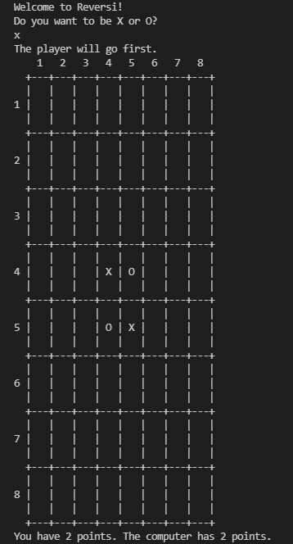
How to play
Choose your tile
Generate board
Starting player is chosen randomly
Player - ai makes move and updates the board
Game ends when all spots are filled

Slide 5
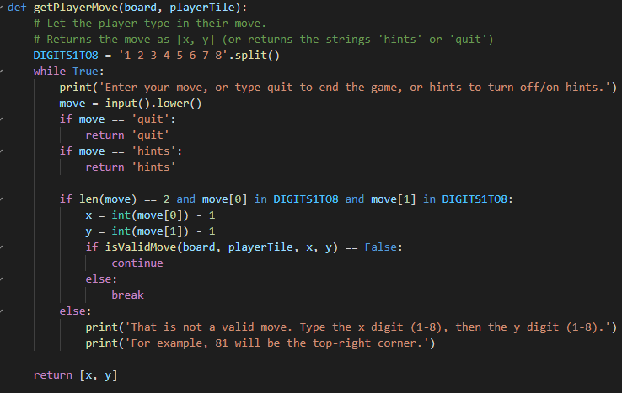
player move
Once we get any input we would check
Quits - ends game
Hints - displays all possible move
Move -To make a move you will enter (y,x) like 35 for col 3, row 5
Valid move- updates move and then ai plays
Invalide move- displays invalid move and waits for another input

Slide 6
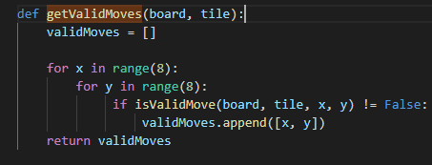
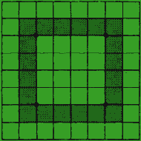
Ai move
Get a list of all of the possible moves
Check if any possible moves are
Corner
Edge
Center 4*4 spots
Located on row 2 or 7 and column 2 or 7
Spots adjacent to corners
Check if there are moves in each category in that specific order, if there are multiple moves, we would return the move that would flip the most tiles.

Slide 7


Demo Example

Slide 8
Final project goals
Reduce option
During the mid game, the main strategy is to maximize the number of available moves, while minimizing your opponent's moves. Keeping your pieces grouped together gives your opponent fewer options to play.
Force bad move
If you are forced to make a bad move late into the game, it is usually a good idea to play in an area where an odd number of empty squares are left.
Save move for later
Moves that can be played by only one player should be saved for last to priority moves that could change the course of the game

Slide 9
References
Othello.pdf (fgbradleys.com)
http://mcts.ai/code/python.html
Reversi - Wikipedia
How to play Othello | Official Rules | UltraBoardGames

